Slide 1
Biostatistics for RNA-seq analysis
Day 2 - Morning session
Multivariate statistics and data integration

Slide 2
Overview
Principal components analysis
Motivation
Interpretation & estimation
Examples
Partial Least Squares data integration
Motivation
Interpretation & estimation
Examples
Two-way orthogonal PLS data integration
Motivation
Interpretation
Examples

Slide 3
Motivating scenario
Suppose we have a dataset X, with N samples and p genes
Lets make it more concrete: gene expression values
Typically, expression follows a pathway structure
How can we visualise the relationship between genes in an efficient way
How to inspect these gene expression values and their correlations?

Slide 4
Example: bivariate data
Suppose we have two genes
They are positively or negatively correlated
How would you represent these data, do you need two dimensions? Or just one?
In general, aggregate data across direction of maximal variance
Live R example

Slide 5
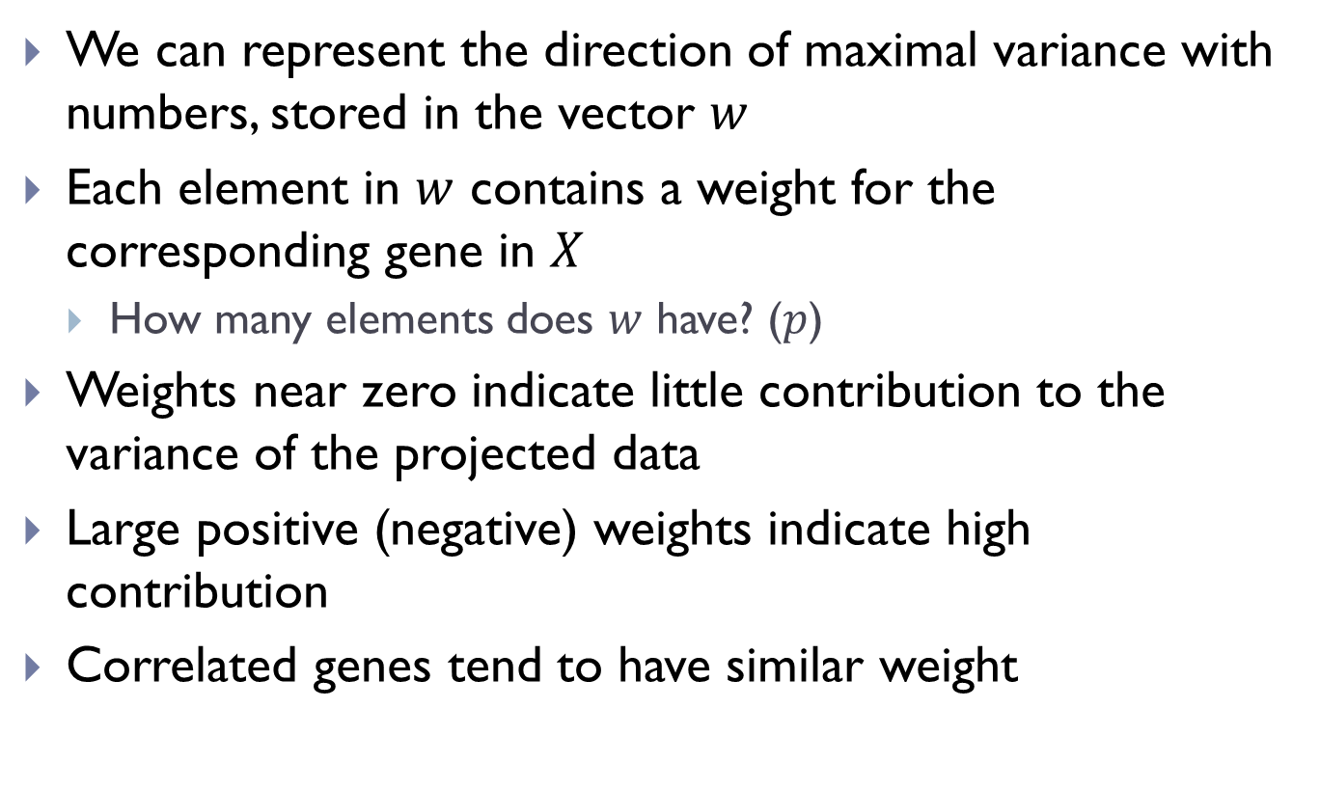
Weights to represent the best direction
We can represent the direction of maximal variance with numbers, stored in the vector $w$
Each element in $w$ contains a weight for the corresponding gene in $X$
How many elements does $w$ have? ($p$)
Weights near zero indicate little contribution to the variance of the projected data
Large positive (negative) weights indicate high contribution
Correlated genes tend to have similar weight

Slide 6
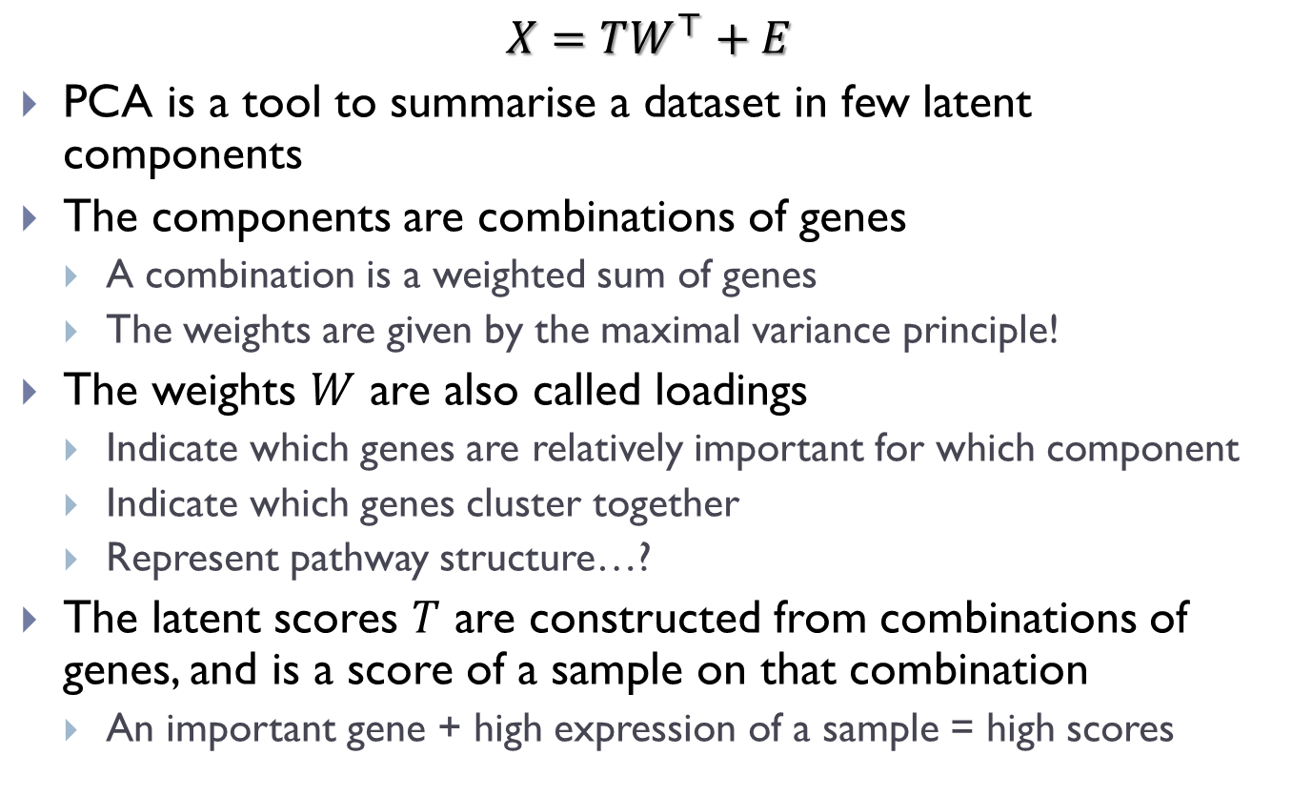
Principal components analysis
$$X=TW^{⊤}+E$$
PCA is a tool to summarise a dataset in few latent components
The components are combinations of genes
A combination is a weighted sum of genes
The weights are given by the maximal variance principle!
The weights $W$ are also called loadings
Indicate which genes are relatively important for which component
Indicate which genes cluster together
Represent pathway structure…?
The latent scores $T$ are constructed from combinations of genes, and is a score of a sample on that combination
An important gene + high expression of a sample = high scores

Slide 7
Interpretation
Loadings or weights
A number for each gene
Indicates which genes are important
Group of genes with large loadings might represent pathways
Scores or latent variables
A number for each sample
Indicates which samples have high expression of that gene (perhaps an outlying sample?)
Group of scores/samples may be clustered together, because they have similar expression values of important genes.

Slide 8
R exercises

Slide 9
Overview
Principal components analysis
Motivation
Interpretation & estimation
Examples
Partial Least Squares data integration
Motivation
Interpretation & estimation
Examples
Two-way orthogonal PLS data integration
Motivation
Interpretation
Examples

Slide 10
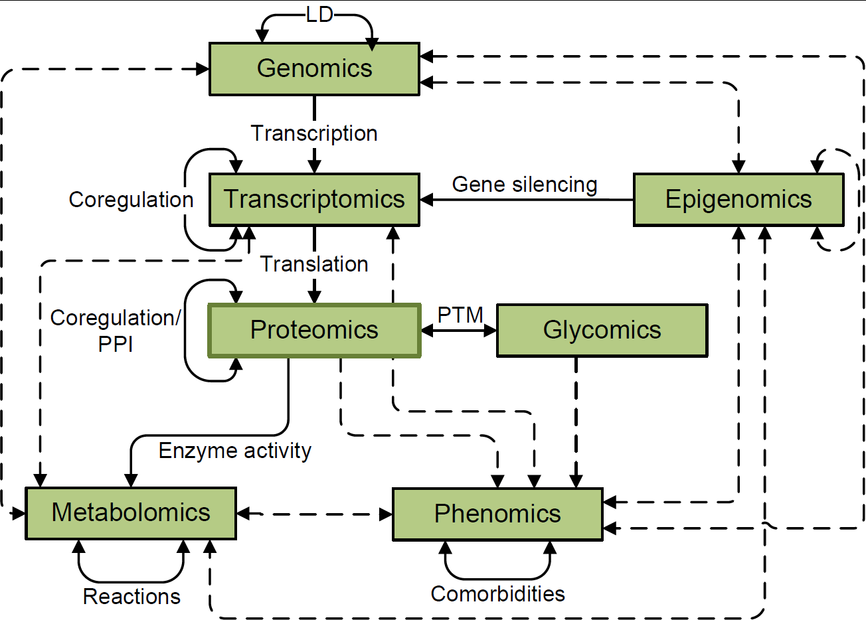
Multiple omics data
Recent advances in technology provided many types of biological datasets (omics)
Different levels of biological variation measured on same samples
There is a need for integrative approaches

Slide 11
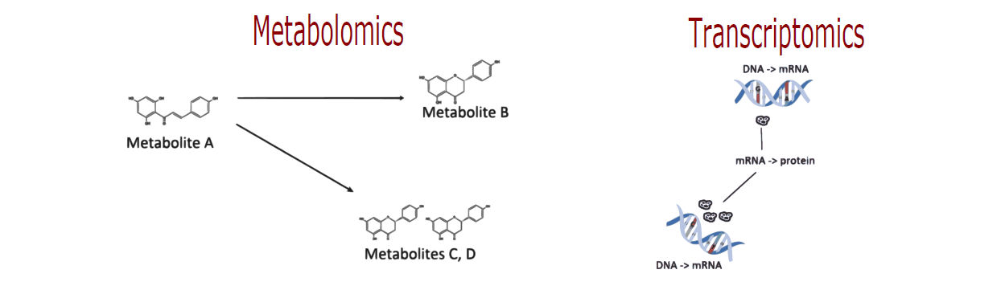
Integrative approaches: aims
Some questions to answer:
How does variation in transcriptome and metabolome relate?
Which (types of) molecules are inducing this variation?
Can we benefit from a joint/integrative analysis?

Slide 12
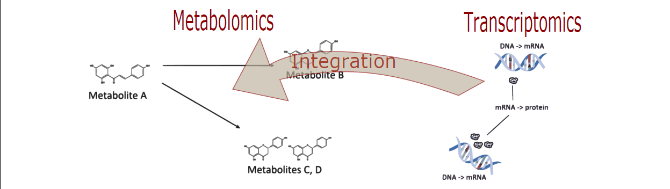
Integrative approaches: aims
Some questions to answer:
How does variation in transcriptome and metabolome relate?
Which (types of) molecules are inducing this variation?
Can we benefit from a joint/integrative analysis?

Slide 13
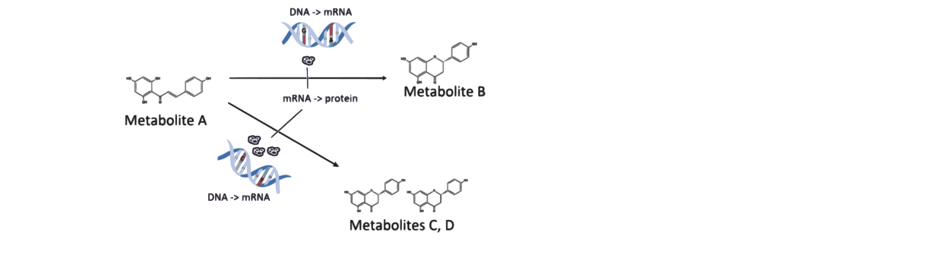
Integrative approaches: aims
Some questions to answer:
How does variation in transcriptome and metabolome relate?
Which (types of) molecules are inducing this variation?
Can we benefit from a joint/integrative analysis?

Slide 14
Integrative approaches: means
There is typically
High correlation among transcripts.
High correlation among metabolite measurements.
Relation between transcripts and metabolites.
Latent variable approach: few independent latent variables drive association
These latent variables represent latent unknown “pathways”

Slide 15
Example: bivariate data
Suppose we have two genes, and two metabolites
Measured on the same samples
The variance of gene A is larger than the variance of gene B
Also, the variance of metabolite A is larger than the variance of metabolite B
Furthermore, only gene B and metabolite A are correlated
Which genes and metabolites will get high weight according to PCA?
What if you would look at the relation between genes and metabolites?

Slide 16
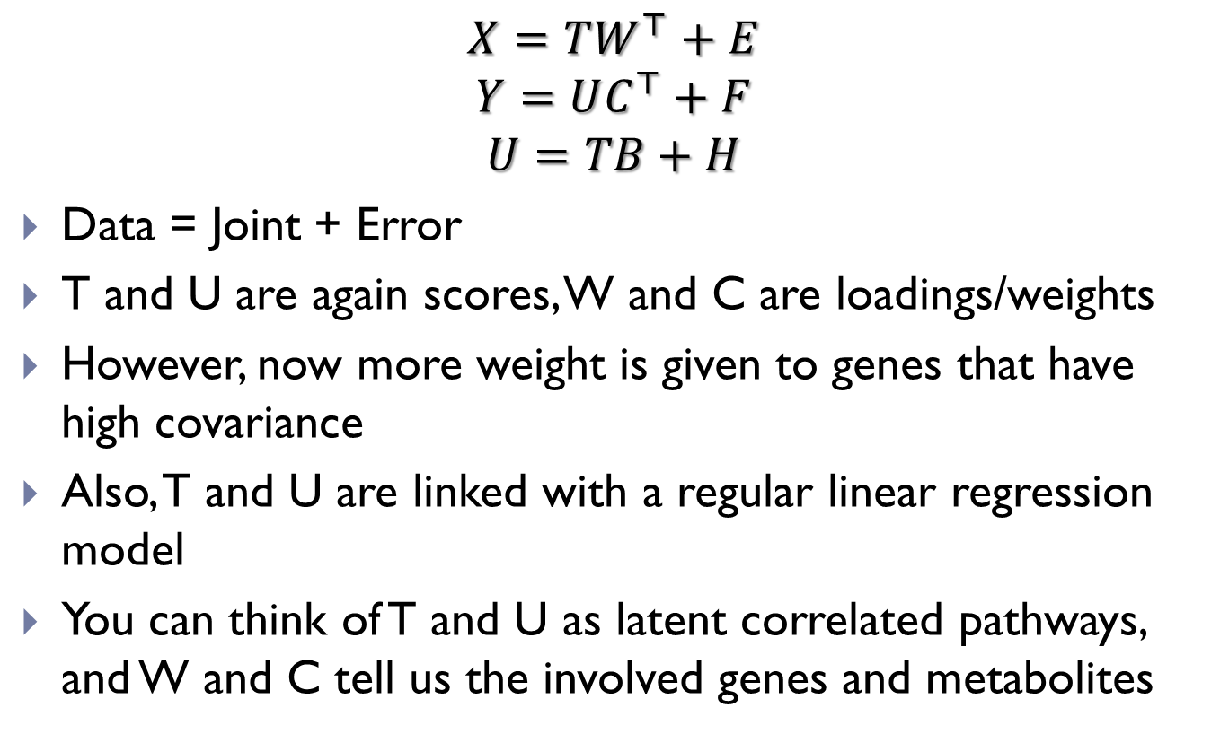
Partial Least Squares
$$X=TW^{⊤}+E$$
$$Y=UC^{⊤}+F$$
$$U=TB+H$$
Data = Joint + Error
T and U are again scores, W and C are loadings/weights
However, now more weight is given to genes that have high covariance
Also, T and U are linked with a regular linear regression model
You can think of T and U as latent correlated pathways, and W and C tell us the involved genes and metabolites

Slide 17
Partial Least Squares: interpretation
Loading values per gene or metabolite
High loading values indicate high contribution to the joint part
High loading values for the same components indicate co-variation of the respective genes/metabolites
Genes with positive and negative loading values are negatively correlated for that component
Scores per sample
Representation of data relative to the most important genes
Can also detect outliers

Slide 18
Quick recap
PCA maximises variance and looks for correlations within datasets
PLS maximises covariance and looks for correlations between datasets
Loadings and scores have the same interpretation of indicating importance
However, distinguish importance with respect to …

Slide 19
Sources of variation
Biological experiments lead to covariation between samples
Expression and metabolism go up and down together
One source of covariation is truly biological
They go up and down because they are truly biologically connected
This is what we want in the joint part!
Other sources of variation is technical, artificial
Batch effects, measurement error, scale & distribution differences, etc
This is what we NOT want in the joint part!

Slide 20
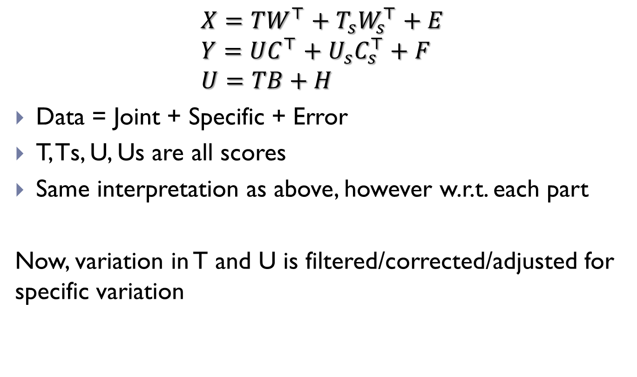
Two-way Orthogonal PLS
$$X=TW^{⊤}+T_{s}W_{s}^{⊤}+E \\ Y=UC^{⊤}+U_{s}C_{s}^{⊤}+F \\ U=TB+H$$
Data = Joint + Specific + Error
T, Ts, U, Us are all scores
Same interpretation as above, however w.r.t. each part
Now, variation in T and U is filtered/corrected/adjusted for specific variation

Slide 21
Summary
Principal components analysis
Motivation
Interpretation & estimation
Examples
Partial Least Squares data integration
Motivation
Interpretation & estimation
Examples
Two-way orthogonal PLS data integration
Motivation
Interpretation
Examples

Slide 22
R exercises

